Slide 1
Audit example
Title
Author names and health board
Health Board Logo
Introduction
Methodology
Discussion
Background
Example: inclusion criteria applied (Figure 1) .
Inclusion criteria
Exclusion Criteria
Figure 1. Inclusion and exclusion criteria
Results
Example: 74 new patients were seen (Table 1) .
Table 1 . Explain what the table shows
Recommendations and actions
Aim
Objectives and standards
Conclusion
.
References

Slide 2
Health Board Logo
Case report
Title
Author
Introduction
Diagnosis
Future Considerations
Treatment Plan
Case Report
Medical History
Social History
Patient
Gender
Age
Dental History
Recall examination
Appointments
Discussion
Examination
Challenges
Conclusion
May want to include charting, photographs or radiographs here
.
References

Slide 3
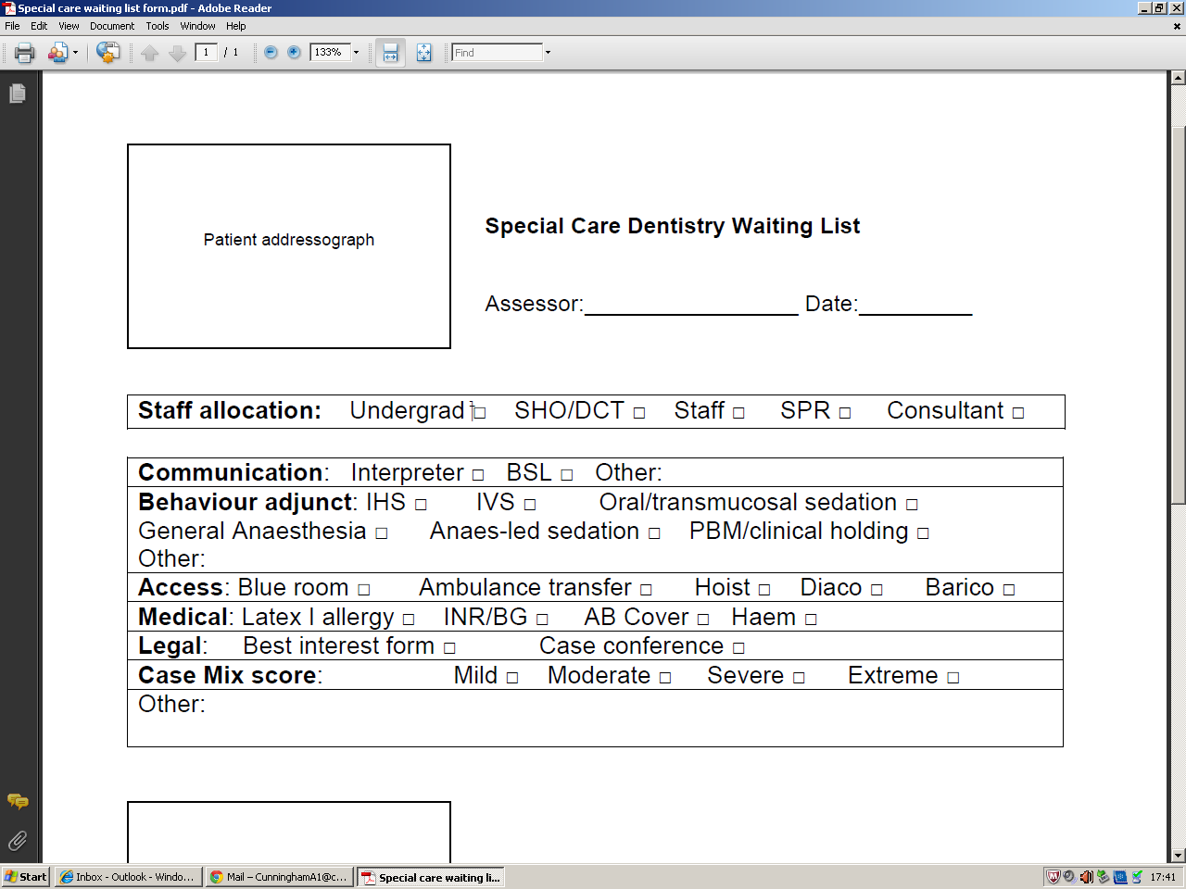
Waiting times for new patient
Special Care Dentistry (SCD) consultant clinic in
University Dental Hospital (UDH), Cardiff
– A retrospective audit
Cunningham A ¹ , Kelly G ² (Cardiff and Vale University Health Board )
Introduction
Cycle 2 of Audit
Discussion
Patients requiring special care dentistry (SCD) are entitled to access services that meet their individual needs¹. The SCD department in UDH, run a monthly new patient consultant clinic for assessment and treatment planning of patients according to established referral criteria.
Aim:
To gather baseline data for new patients seen in special care consultant clinic to evaluate if changes made have improved standards and efficiency of SCD service delivery
There were difficulties identifying new patient referrals electronically in the first audit cycle. The development of a proforma has made patient outcome information more accessible for data collection.
Separate clinics for new and review SCD patients has greatly increased the number of new patient referrals seen on SCD consultant clinics. It was anticipated this would reduce RTT. Limitations in accessing information regarding cancelled appointment may have impacted results, as these patients have complex medical and social problems, which can result in more cancellations and access barriers than the general population⁵. There is confusion in the guidance as to what constitutes first treatment and this is not specifically related to SCD². This will need to be discussed at a departmental meeting to agree if the standards set, in this audit, are appropriate.
Staff changes and shortages, with only one consultant clinic monthly, resulted in increased RTT. Patients requiring GA have longer RTT and assessment to treatment times in comparison to other treatment modalities. As patients requiring SCD often have associated co-morbidities, safe provision of GA is usually provided in short stay surgical unit (SSSU) in the main hospital, were there is only provision for one list monthly and is subject to short notice cancellation.
Although standards were not met, there was improvement in recording of BDA case mix score and receipt of referral to treatment times in the second audit cycle. This audit identifies the need for additional staff and clinical sessions to meet the needs of this patient group.
Background
Methodology
Referral to treatment times (RTT)
Time from referral to hospital for treatment.
Welsh Government targets² for NHS RTT waiting times:
At least 95% of patients waiting to start treatment must have waited less than 26 weeks from referral to treatment
100% of patients not treated within 26 weeks must be treated in 36 weeks.
The clock will stop after the initial appointment, if discharged or referred to another speciality
Audit approval obtained. Day sheets and proformas retained were used to identify SCD new patient referral to undertake a retrospective audit between April and October 2017 applying inclusion criteria (Figure 3) .
Inclusion criteria
New patient referrals to SCD
Including existing patients of UDH seen before or in other departments
Attending special care consultant clinics between April and October 2017
Exclusion Criteria
Recall or review patients, already under the care of SCD
Did not attend (DNAs) or cancellations not reallocated to SCD clinic in the specified time frame
Patient files that were not accessible for data collection
BDA case mix model:
Use of BDA case mix score³ (Figure 1) can aid communication of the complexities involved in the individual patient case to other members of the dental team⁴.
Figure 3 . Inclusion and exclusion criteria
Results
74 patients were identified from day sheets (Table 1) .
As per the inclusion criteria, 49 new patient referrals, 23 males and 26 females, with an age range from 16 to 91 years, were retrospectively reviewed.
Standards were not met (Table 1), with 35% of patients seen within 26 weeks RTT and 36% of patients commencing treatment by 36 weeks. RTT range was three to 57 weeks, with an average of 35 weeks. The range for initial assessment to first treatment was one to 57 weeks, with an average of 7 weeks. Patients were treated with a range of treatment modalities (Figure 4), with day case General Anaesthesia (GA) having longer treatment waiting times.
Objectives and standards
 | Number of patients (N = 74)
New patients | 49
Recall / Reviews | 4
Cancellation (on day/short notice) | 3
DNA | 17
Unable to obtain file | 1
Identify management of new patient referrals seen on special care consultant clinic in UDH, in 2016 and 2017.
STANDARDS:
Table 1 . Breakdown of patients from consultant clinic day sheets
95% of new patient referrals, should have their initial appointment within 26 weeks of receipt of referral
100% of new patient, should have their first treatment appointment within 36 weeks of receipt of referral (excluding when the clock stops)
Recommendations and actions
100% of new patient referrals, should have a recorded BDA case mix score³ at assessment
Discuss results with departmental lead and present at monthly audit meeting. Future staff changes, with appointment of full-time consultant in SCD and sedation may allow for increased capacity and frequency of SCD joint consultant clinics.
Discuss increasing capacity of SSSU GA lists.
Arrange delivery of training sessions on use of BDA case mix model to SCD dental team members. This should include case-based discussions, allowing for calibration of the tool use by staff members.
Analysis should be undertaken into reasons for increased RTT and re-audited, once staff and service provision changes have been implemented.
CASE MIX | O | A | B | C
Ability to communicate | 0 | 2 | 4 | 8
Ability to co-operate | 0 | 3 | 6 | 12
Medical status | 0 | 2 | 6 | 12
Oral risk factors | 0 | 3 | 6 | 12
Access to oral care | 0 | 2 | 4 | 8
Legal and ethical barriers | 0 | 2 | 4 | 8
Banded Total Weighted Score:
0:
1-9:
10-19:
20-29:
30+:
No complexity
Mild
Moderate
Severe
Extreme
Standard | Target (%) | Results 1st Cycle (%) | Results 2nd Cycle (%) | Met (%)
RTT <26 weeks | 95 | 62 | 35 | N
Referral to first treatment <36 weeks | 100 | 27 | 36 | N
BDA case mix score recorded | 100 | 62 | 67 | N
Figure 1. BDA case mix model
Cycle 1 of Audit
A retrospective audit was undertaken between April and August 2016. 13 new patient referrals were identified. Standards were not met, with 62% of patients seen within 26 weeks RTT and 27% commencing treatment by 36 weeks. A BDA case mix score was completed for 62% cases.
The majority of the patients were recalls and excluded from data collection. A decision was made to have two separate clinics for review and new SCD patients.
A proforma was introduced (Figure 2) to ensure outcomes and improve traceability. Discussion with staff allowed promotion to record a BDA case mix score.
Table 2 . Summary of standards met
Conclusion
Staff changes, and shortages can impact negatively on the efficiency of a referral service. There is a need to promote a shared care approach in SCD, between primary and secondary dental services, to provide appropriate and timely dental care. This is being aided by the South-East Wales Managed Clinical Network (MCN), who aim to implement a robust SCD referral pathway between General, Community and Hospital Dental services.
References
Figure 4. Treatment modality outcomes
1. Equality Act (2010). England and Wales. Available at: http://www.legislation.gov.uk/ukpga/2010/15/pdfs/ukpga_20100015_en.pdf (Accessed 14 Sept 2018)
2. Welsh Assembly Government [WAG]. (2007). Welsh Health Circular 75. 2009 Access Project – Supplementary Guidance for Implementing 26-week patient pathways Available at: http://www.wales.nhs.uk/sitesplus/documents/863/15-J-037%20WHC%202007%2075.pdf (Accessed 14 Sept 2018)
3. British Dental Association [BDA] (2007). Case-Mix Model Training Pack.
4. Bateman, P. Arnold,C. Brown, R. Foster, L.V. Greening, S. Monaghan, N. and Zoitopoulos, L. (2010). BDA special care case mix model. British Dental Journal 208 (7) 291-296
5. Kelly, G. and Nunn, J. (2012) Access to care: waiting times for special care patients accessing specialist services in a dental hospital. Journal of Disability and Oral Health 13(1), 27-34
A BDA case mix score was recorded for 67% of patients, identifying a further training need, as it was not consistently used by all clinicians. For those recorded, the case mix score ranged from 9, mild complexity, to 44, extreme complexity, with a median score of 25, severe complexity
Figure 2 . Proforma used to record treatment outcomes on clinic.
Authors 1. Specialist registrar in Special Care Dentistry
2. Consultant/ Honorary Senior Lecturer Acute & Special Care Dentistry

Slide 4
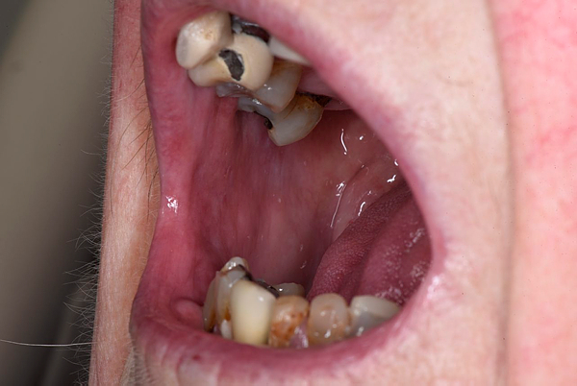
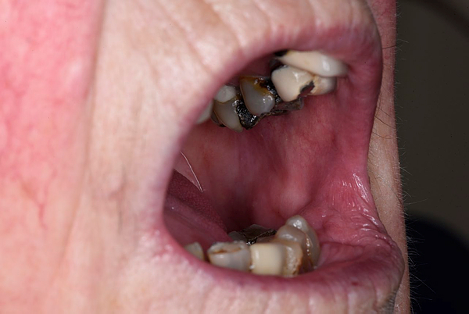
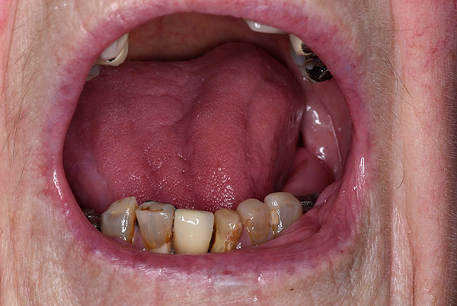
A Time of Transition
Impact of Declining Independence on Dental Management of Older People
Cunningham A (Specialist Registrar in Special Care Dentistry, Cardiff and Vale University Health Board )
Introduction
Stabilisation Treatment Plan
Overcoming Challenges
The UK population is getting older, with 18% aged over 65 years, projected to risk to 24% by 2046 ^{1.}
There are increasing numbers of older people living independently at home, with 2 million people over 75 years living alone, of which 1.5 million are women ^{2.}
Frailty in later life can compromise independence resulting in a progressive decline in physical, mental and social functions, which will have implications for oral care management.
Resolve acute bacterial parotitis
Prevention
High fluoride toothpaste, fluoride mouthwash at alternate time to tooth brushing⁴
Salivary substitutes
Oral hygiene demonstration
Dietary advice
3. Restorations under LA – UL6, LR2, LL2, LL3
Extraction unrestorable UR2 UR1, LL7
Provision P/- (Figure 2)
Hygiene appointments – OHI, scaling and topical fluoride 3/12
Recall 3/12 based on caries risk⁵
Liaison with GP regarding decline, increased confusion and weight loss.
Referral to Older Person Care Assessment Unit:
Physiotherapy
Occupational therapy
Dietician –short term Oral Nutritional Supplements (ONS) prescribed
Speech and Language Team assessment - dysphagia related to Barrett’s oesophagus
Care management team – carers four times weekly to help with meals and showering
Age Concern - volunteer support for appointments
Use of standard wheelchair for long distances
Accessible Easy-read information
Short regular appointments
Rapport building with patient so will confide if experiencing challenges
Use of dental team skill mix – hygienist to reinforce preventative regime
Case Report
Medical History
Secondary Sjögren's Syndrome
Angina (stable)
Rheumatoid Arthritis (RA)
Osteoporosis
Barrett’s oesophagus
Reflux
History of falls recently
Intermittent dizziness
Hearing aids
Wears glasses
Dental History
Referred from Rheumatology to Oral Medicine with Suspected Sjögren's Syndrome
Referred to Special Care Dentistry with problems maintaining dentition in 2010
Female
83 years
Figure 2. Upper partial denture design with no clasps due to limited manual dexterity as a result of Rheumatoid Arthritis and visual decline. Avoids impinging on gingival margins to aid oral hygiene
Social History
Lives alone, brother 20 miles away
Mobilises with walking stick –difficulty with stairs and walking long distances
Travels alone by bus to appointments
Retired
Volunteers at sewing class once weekly
Cleaner comes to house once weekly
Future Considerations
Decline During Treatment
Change focus from interventional to preventive dentistry
Include carers in oral hygiene practices – written oral care plan
Nutritional needs – ONS increasing caries risk ⁶
Capacity assessment/best interest decision may be required - time/task specific ⁷
Access to domiciliary care - increasing frailty
Dysphagia & dental care - risk assessment ⁸
ACCESS
Not confident attending alone or on bus due to recent falls - taxis – financial implication
Unable to recline or tolerate long appointment times due to worsening kyphosis, RA & xerostomia
Requires assistance for transfer to dental chair
se of support pillows and assistance for transfer to dental chair
Recall Appointment
Had not attended for dental recall in one year
Friend accompanying to appointment
Had fall 6/12 previously getting off bus and lost confidence getting bus alone
Presenting complaint: Pain right preauricular region and bad taste in mouth
NUTRITION MAINTENANCE
Loss of appetite/ weight loss – increased frailty
Unable to stand to prepare meals - fear of falling
Unable to independently shop – cleaner collects once weekly
Examination:
Tenderness on bimanual palpation of right parotid gland with pus from parotid duct
Poor oral hygiene with generalised food packing and plaque deposits
Severe xerostomia with Challacombe score of 9 ³
Heavily restored dentition (Figure 1)
Lost post crown UR2 – retained root
New carious lesions UR6, UR1, LR2, LL2, LL3, UL6, LL7
Teeth Present:
Conclusion
DIFFICULTY WITH PERSONAL HYGIENE
Decreasing manual dexterity
Concerned about showering in house alone due to falls and dizziness
Voluntary agencies are essential in minimising social isolation for older people in the community, especially with predicted trends of increasing older people living alone.
This case highlights the challenges for the patient and the dental team from independence to frailty. Information sharing and multidisciplinary team working is pivotal to ensure a patient-centred approach for older people, during this time of transition.
 | 6 |  | 4 | 3 | 2* | 1 | 1 | 2 | 3 | 4 | 5 | 6
 |  |  | 4 | 3 | 2 |  | 1 | 2 | 3 | 4 | 5 |  | 7
SOCIAL EXCLUSION
Contact with brother over phone
Stopped going to sewing class due to loss of confidence in going out alone
Increased reliance on friends to visit and help with daily tasks
COGNITIVE DECLINE
Missed appointments - confusion about appointment dates
Difficulty retaining information from last visit
Increased vagueness describing symptoms
References
Office National Statistics (2017). Overview of the UK population: July 2017. Available at: https://www.ons.gov.uk/peoplepopulationandcommunity/populationandmigration/populationestimates/articles/overviewoftheukpopulation/july2017 (Accessed 22 Nov 2017)
Office National Statistics. (2016). Labour workforce Survey.
Osailan, S. Proctor, G. Shirlaw, P.J. McParland, H. Larkin, G.,Kirkham, B.Challacombe, S. J. (2011) Investigating the relationship between hyposalivation and mucosal wetness. Oral Diseases 17:1;109–114
Public Health England. (2014). Delivering better oral health: an evidence-based toolkit for prevention (Third Edition).
National Institute of Clinical Excellence (NICE) (2004). Dental checks: intervals between oral health review; CG19SIG.
All Wales Special Interest Group/Oral Health Care. (2009) Oral Nutritional Supplementation and Oral Health Guidelines. Available at: http://www.sigwales.org/wp-content/uploads/sipfinalcorrectedapril201053.pdf (Accessed 22 Nov 2017)
Mental Capacity Act (2005). England and Wales.
SIG. All Wales Special Interest Group/Oral Health Care. (2014). Dysphagia and Oral Health. Available at: http://www.sigwales.org/wp-content/uploads/sig-dysphagia-guidelines1.pdf (Accessed 22 Nov 2017)
Challenges Maintaining Dentition
Xerostomia
High caries risk with new carious lesions
Declining oral hygiene
Recurrent parotid infections
Reduced ability to cope with treatment
Figure 1. Heavily restored dentition with poor oral hygiene.

